Slide 2
Respect is at the heart of Pope Francis’ summons in Laudato Si’ to engage in “grateful contemplation of God’s world” (n. 214) which “allows us to discover in each thing a teaching which God wishes to hand on to us” (n. 85). This is an invitation to recognise and respect the sacredness of each element of creation, requiring of us an attitude of humility.

Slide 3
A similar dynamic of respect is evoked by the teaching of Jesus in his list of blessings, called The Beatitudes (Matthew 5:1-12). One of the Beatitudes begins “Blessed are the meek …” (5:4). Meekness, or gentleness, requires the respect and strength to be in right relationship, beginning with our relationship with God and extending to the whole Earth community.

Slide 4
Another of the Beatitudes has a special significance for the Mercy world: “Blessed are the merciful, for they will be mercied” (5:7). Those who show mercy will also receive mercy, and together they will become mercy by their actions. Mercy creates a spiral of right relationships!

Slide 5
There is a mutuality of respect implied here. As we minister to others in mercy, we are called to be open to receive mercy from them, acknowledging the sacredness of those to whom we minister.

Slide 6
That Catherine McAuley operated from a basis of respect and encouraged the same attitude in the early Sisters of Mercy is clear from her words: “Every place has its own particular ideas and feelings which must be yielded to when possible” (Letter to Frances Warde, November 17, 1838).
Catherine respected the different ways and customs that she encountered in each town and was also open to learning from others:
“The adage – ‘never too old to learn’ – is a great comfort to me” (Letter to Frances Warde, September 23, 1839).

Slide 7
We can begin to understand why so many young women were drawn to join Catherine in her works of mercy from these words of hers:
“Be ever ready to praise, to encourage, to stimulate, but slow to censure, and still more slow to condemn”
(from Familiar Instructions)
Catherine respected and fostered the different gifts and talents of each of the early Sisters. By praising and encouraging them, she freed them to be and to give of their best.

Slide 8
The wisdom displayed in Catherine’s words speaks to each of us engaged in Mercy ministry today. Respecting diversity of views and talents and enabling and encouraging others to flourish is our call as well as our challenge.
As Pope Francis instructs, our respect needs to be expansive enough to allow Earth itself to flourish. Being aware of and minimising our personal and ministerial ecological footprints is an important element of the Mercy value Respect.

Slide 9
Think about the people with whom you have interacted today.
Have these encounters been respectful and dignified for you? For others? How do you know?
What are the characteristics of respectful interactions and relationships?
Set aside some time and space where you will not be interrupted for a little while. Notice your surroundings, the view from the window, the sounds, smells and colours of nature.
In what ways do you show respect for God’s unfolding creation?

Slide 10
You are invited to read the following texts:
Genesis 2:7-9, 15
Matthew 5:1-12
When we act respectfully, we are nurturing a culture of right relationships.
What benchmarks for ‘being in right relationship’ are presented in these texts?
Our sacred texts and founding stories provide us with a well-spring of inspiration. Take some time to re-read the reflection on Respect.
What insights into this value are significant for you? Why are they significant?

Slide 11
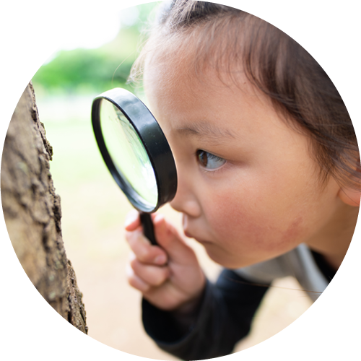
Commit to addressing one issue and schedule time to reflect regularly on the outcomes of your actions.
Our stance towards others, how we view people and all of creation, influences our capacity to be respectful.
Why do we sometimes struggle to be respectful – at home, in our workplaces, in broader society?
Identify some practical ways you can work with others to address issues which flow from a lack of respect – for example: demeaning language, gossip, violence, misuse of social media, pollution and waste of resources.

Slide 12
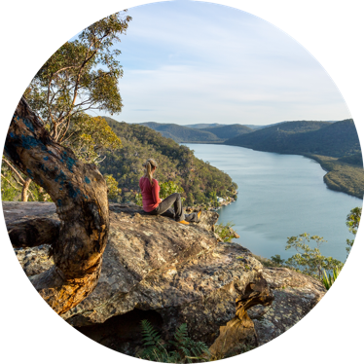
All of creation is interconnected!
How expansive is your approach to respect? What are your limits to respect?
In what ways (locally, nationally, globally) can you and your colleagues use your skills and influence to help sustain our Earth community?
Dreams become reality one step at a time!
How might life be different if we enabled diverse views and talents to be respected, encouraged and celebrated?

Slide 13
We respectfully acknowledge all First Nations Peoples, especially those on whose lands we engage in ministry.
© Mercy Ministry Companions | www.mercyministrycompanions.org.au

